Slide 1




EDA Project on IMDB Ratings Dataset
-- by Kodumurthi Surendra
Data Science
Under the Guidance of
Rapaka Manoj Kumar

Slide 2


Introduction:
Dataset Name: IMDB Ratings Dataset
Source: IMDB movie dataset
Usage: Exploratory Data Analysis (EDA) to study trends in movie ratings
Objective: Understand distribution of ratings and identify influencing factors.
www.sivaacademy.net

Slide 3
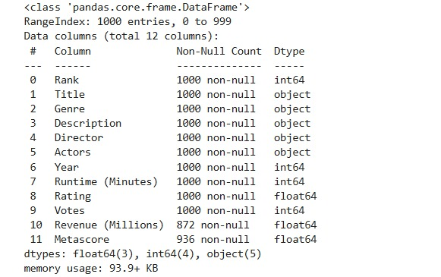
Dataset Explanation:
Dataset contains Imdb Rating characteristics:
Numerical:
- Title
- genre
- Year
- Run time
- Rating
- Votes
Target variable: IMDB Rating (1–10 scale)
.
www.sivaacademy.net

Slide 4
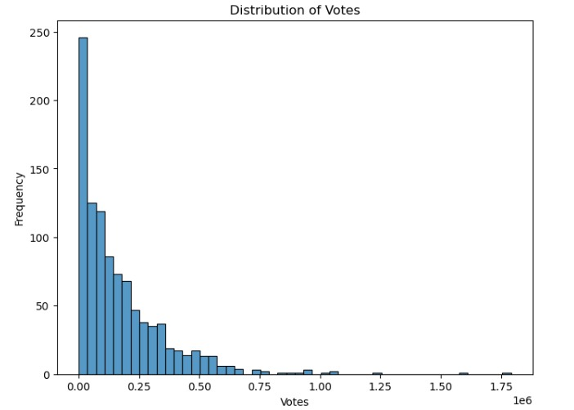
Distribution (Of Votes):
Target variable: Distribution (Ratings)
Most movies receive low to moderate votes.
Only a few blockbusters get extremely high votes.
www.sivaacademy.net

Slide 5
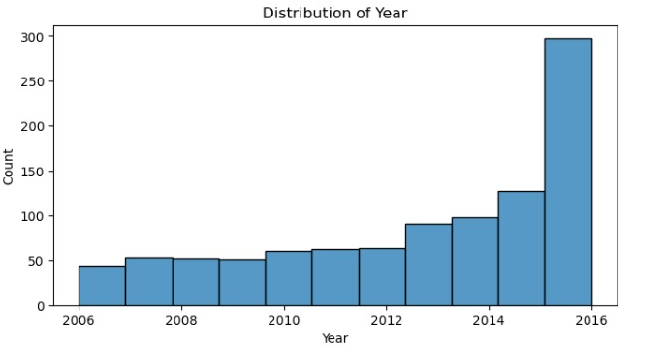
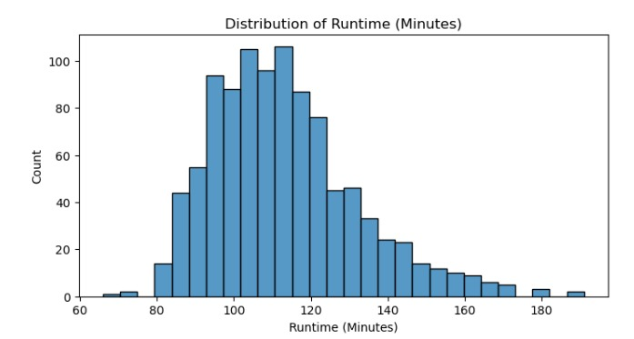
Univariate Analysis:(Numerical)
Movies increased steadily after 2006, peaking in 2016.
The dataset is skewed toward recent years.
Most movies run 90–120 minutes, forming a clear peak.
Very few movies exceed 150 minutes, showing outliers in runtime.
www.sivaacademy.net

Slide 6
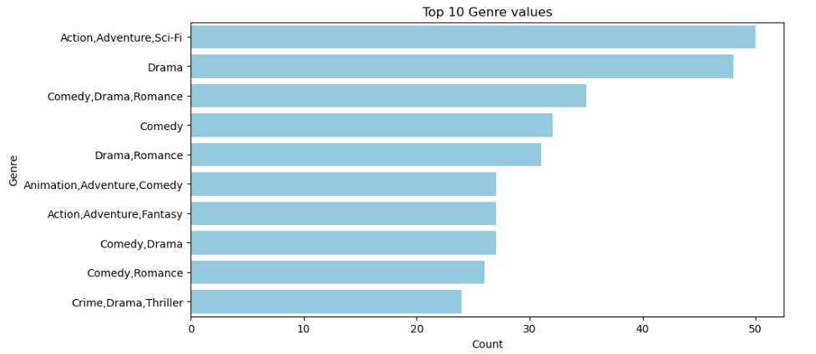
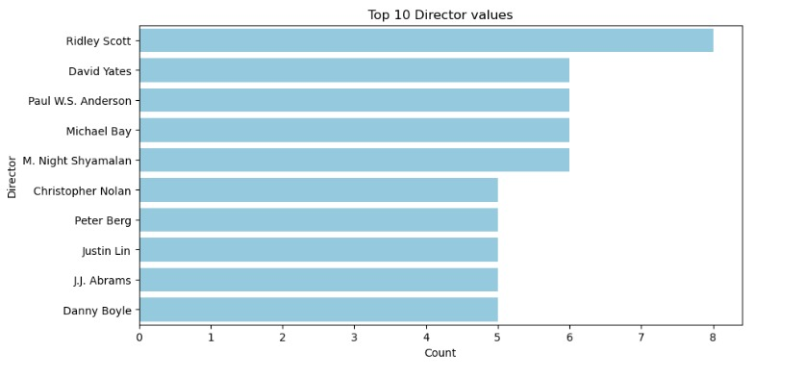
Univariate Analysis : (categorical)
Action–Adventure–Sci-Fi and Drama are the most frequent genres.
Hybrid genres like Comedy–Drama–Romance also appear often.
Ridley Scott leads as the most frequent director, followed by David Yates and Paul W.S. Anderson.
Other key directors include Michael Bay, M. Night Shyamalan, and Christopher Nolan.
www.sivaacademy.net

Slide 7
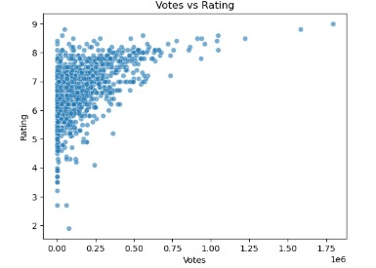
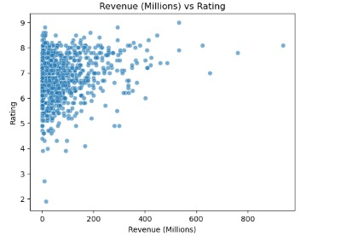
Bivariate Analysis (Numerical vs Target) :
Votes vs Rating → Movies with more votes generally have ratings between 6–8, showing popularity clusters around average-to-good films.
Revenue vs Rating → Revenue shows no strong correlation with ratings; high-earning movies can still have mid-range scores.
Overall → Popularity (votes) aligns somewhat with quality, while box office revenue does not strongly predict ratings.
www.sivaacademy.net

Slide 8
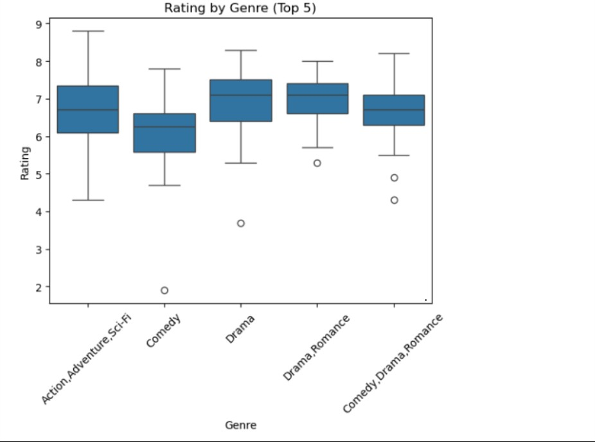
Bivariate Analysis (categorial vs Target) :
Drama and Drama-Romance genres show higher median ratings (around 7–7.5) compared to others.
Comedy has the lowest median rating and more low-rated outliers.
Action-Adventure-Sci-Fi shows a wide spread, meaning ratings vary a lot, from very low to very high.
www.sivaacademy.net

Slide 9
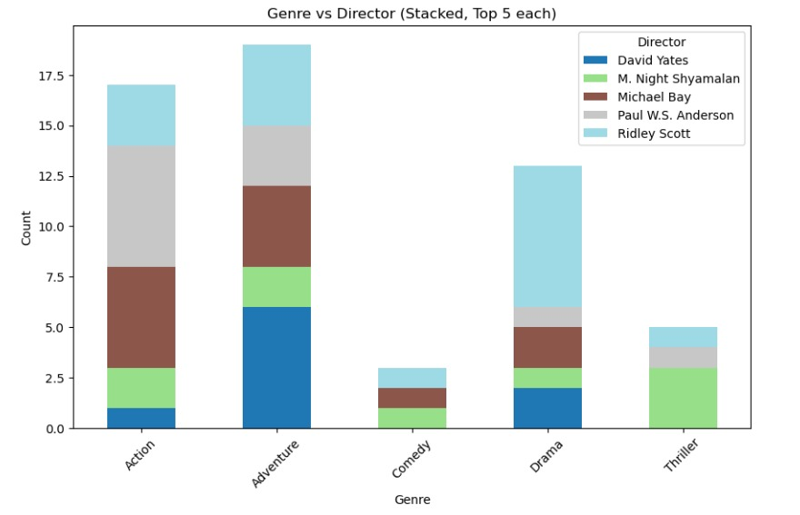
Categorial vs Categorial :
Adventure and Action dominate — these genres have the highest counts among the top directors.
Directors are genre-specialized — Michael Bay and Paul W.S. Anderson appear heavily in Action/Adventure, while Ridley Scott contributes more to Drama.
Comedy and Thriller are less frequent — only a small number of top directors appear in these genres compared to Action/Adventure.
www.sivaacademy.net

Slide 10
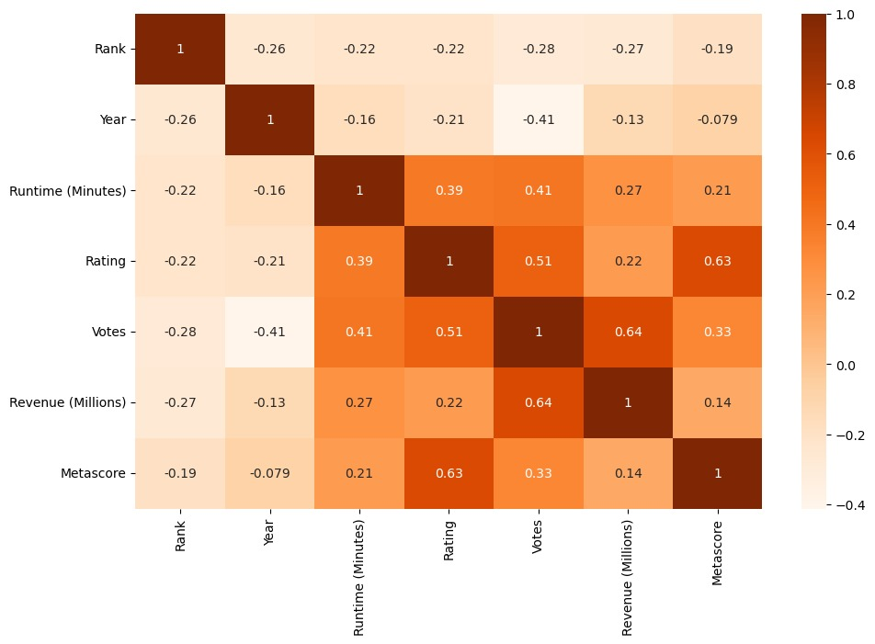
2) Correlation Heatmap:
Rating is most correlated with Metascore (0.63) and Votes (0.51) — meaning critic scores and audience size both align with IMDB ratings.
Votes and Revenue (0.64) are strongly correlated — popular movies earn more money.
Year and Votes (-0.41) show a negative correlation — older movies tend to have fewer recorded votes.
www.sivaacademy.net

Slide 11
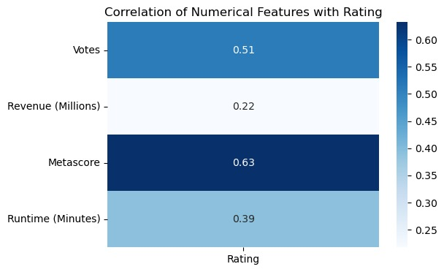
3) Correlation with Target (Num vs Target) :
Metascore (0.63) has the strongest positive correlation with IMDB Ratings.
Votes (0.51) also correlate well — more votes usually mean higher ratings.
Runtime (0.39) shows a weaker link, while Revenue (0.22) barely correlates with Ratings.
www.sivaacademy.net

Slide 12
Target Vs Feature Analysis:
Metascore strongly correlates with higher IMDB Ratings.
Votes show a positive trend, but effect plateaus at high counts.
Runtime has a weak positive link up to ~180 minutes.
Drama/Biography genres rate higher than Action/Comedy.
www.sivaacademy.net

Slide 13
Key Insights:
Most movies rated between 6–8, central tendency bias in IMDB
High-rated movies (9+) are rare and often classics
Votes drive visibility, not necessarily higher ratings
Drama/Biography genres consistently score better
www.sivaacademy.net

Slide 14
Recommendations:
Normalize skewed features (runtime, votes) before modeling
Stratify ratings by release decade to detect trends
Handle extreme outliers separately
Streaming platforms can prioritize higher-rated genres
www.sivaacademy.net

Slide 15

Thank You

